Slide 1

CS499 - Open Source software development
Lecture #07: How to contribute to Open Source Software:
The Process
Dr. Igor Steinmacher

Slide 2
What is it about
It is about contributing to Open Source!!!
Different ways to do it …. HOW?
Code
Documentation
Support
Translation
Issues
etc.

Slide 3
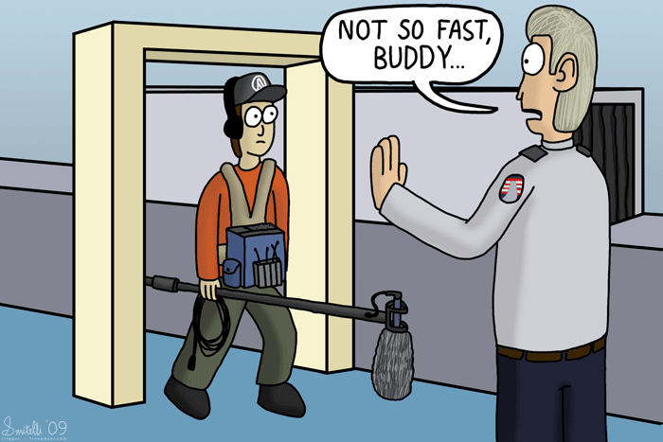
And… how to contribute?
https://www.triggerandfreewheel.com/comic/not-so-fast-buddy

Slide 4
It can be tough!

Slide 5
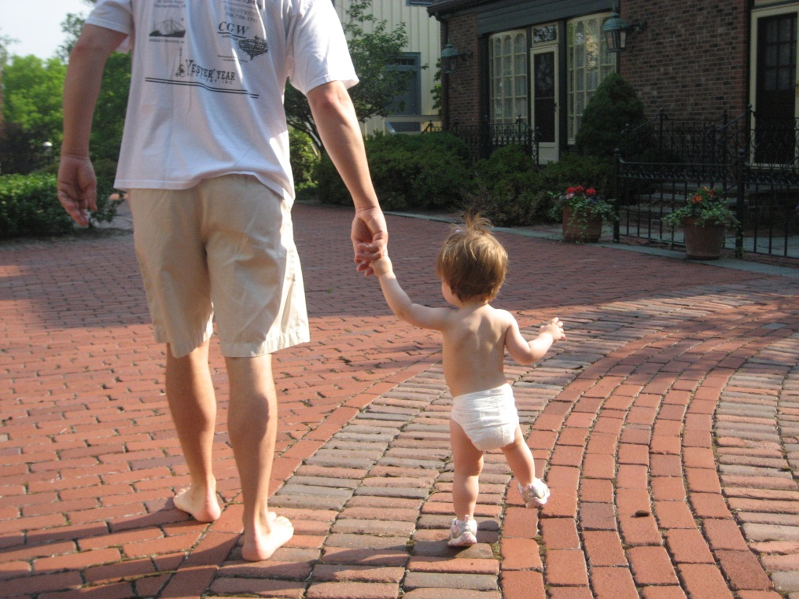
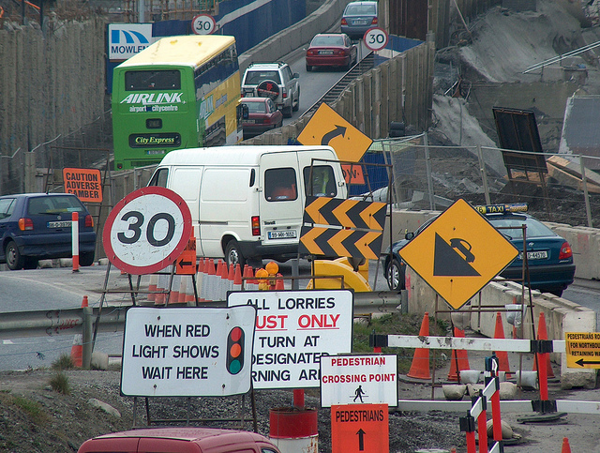
Context
“Newcomers are explorers who must orient themselves within an unfamiliar landscape...”
[Degenais et al. 2010]
... and need support on their first steps
B. Dagenais, H. Ossher, R.K.E Bellamy, M.P. Robillard and J.P. de Vries, Moving into a new software project landscape, in ICSE 2010.

Slide 6
Barriers ahead!

Slide 7
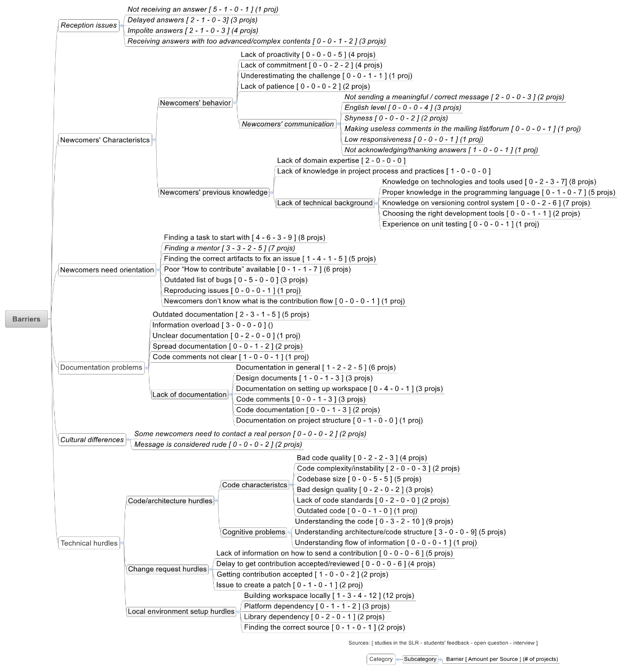

Slide 8
And… how to contribute?
Yet…
Proactivity
Social skills
Technical skills
Deviate from some barriers
Persist to overcome others

Slide 9
And… how to contribute?
The contribution process is project-dependent
How to interact
Tools and support infrastructure
Submission and Review process

Slide 10
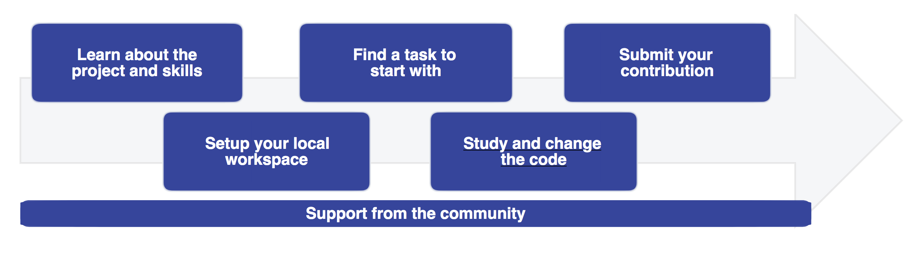
THE Process

Slide 11

Open Source == Community
Do not hide
Do not be afraid of them
Do not mind the rude/offensive messages (a hard one)
Understand the responder’s side
Always: do your part
Standards
Respect
Be Proactive

Slide 12

Learn about the project!
Project page
Where is the repo/source code?
Issue tracker
Communication means
Wikis, documentation repos, etc.

Slide 13
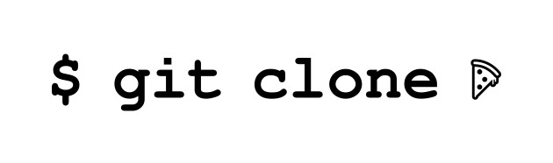
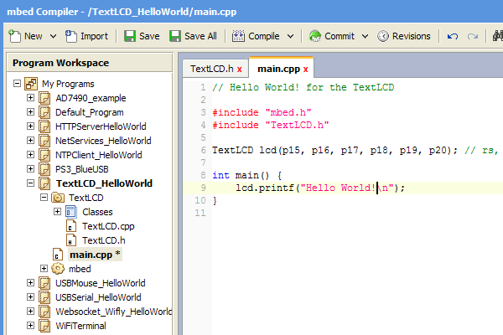
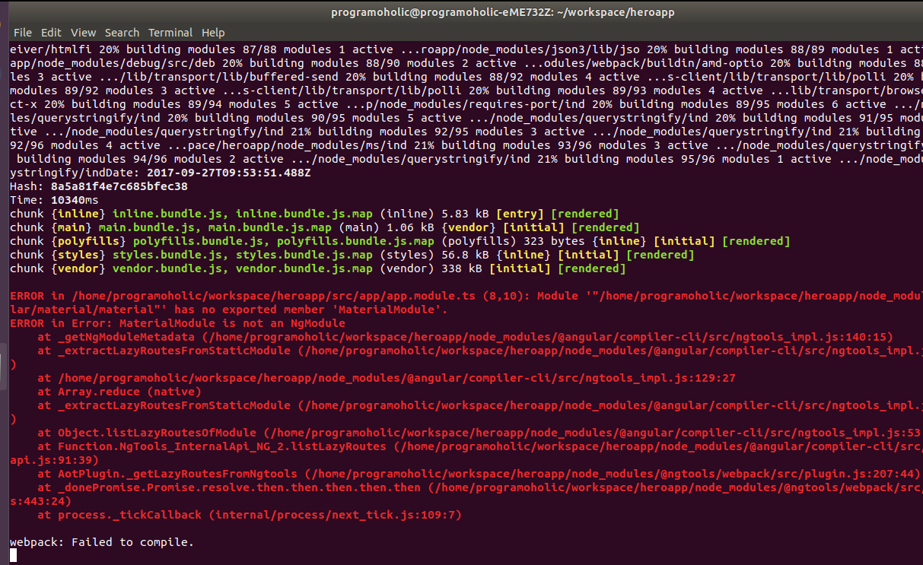
Set up your local thing

Slide 14
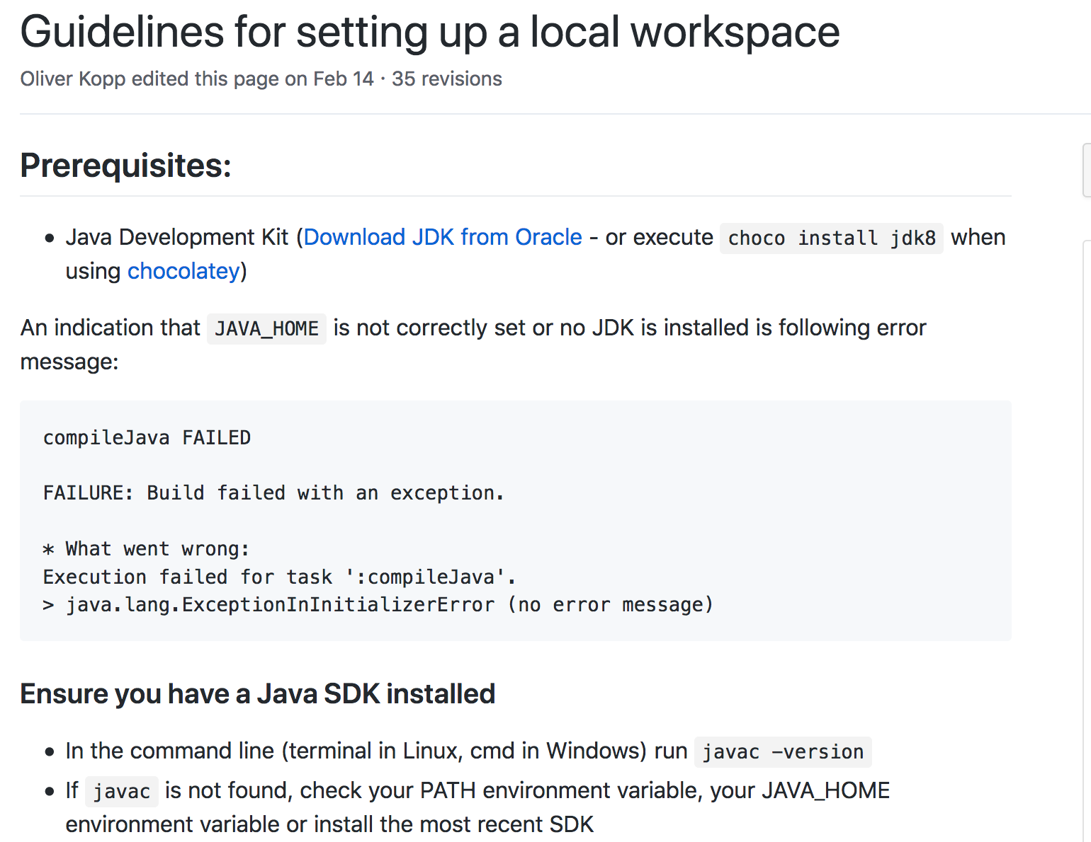
Set up your local thing
OS dependent?
Specific versions?
IDE?
Disk availability?

Slide 15

Pro tip…

Slide 16

Finding a task

Slide 17
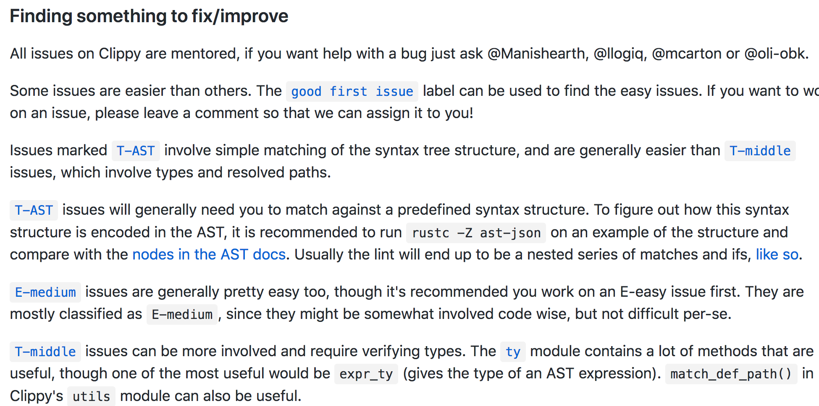
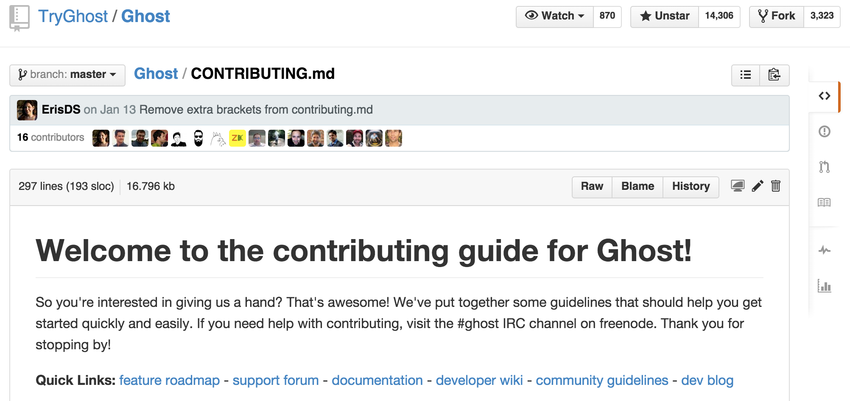
Finding a task
Read the project guidelines

Slide 18

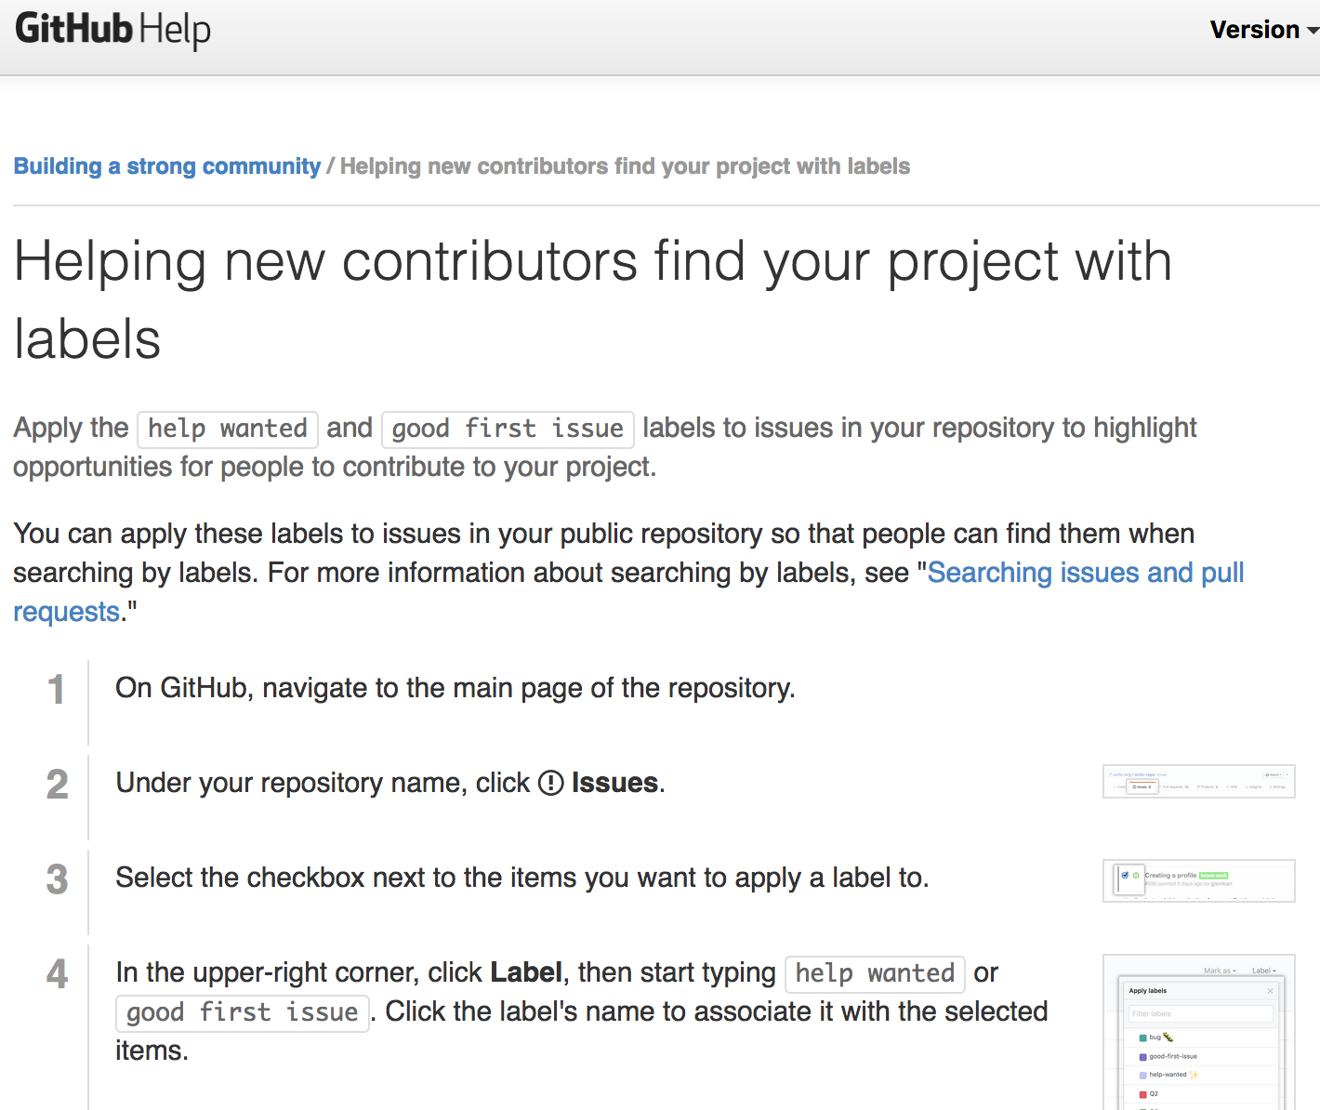
Finding a task

Slide 19

Finding a task
Reproduce the issue
Confirm with the community
Make the community aware
Dive into the code!

Slide 20
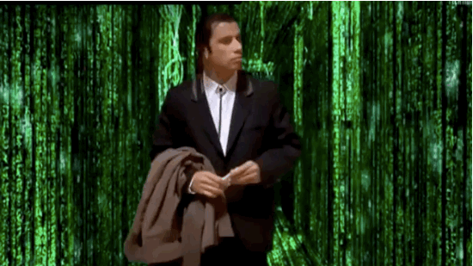
Dive into the code

Slide 21

Apply your changes

Slide 22
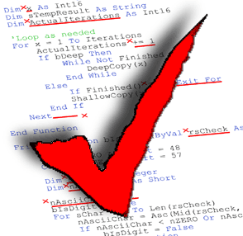
While making changes
Beware the standards
Are tests needed?
Re-read the contribution guidelines

Slide 23


Slide 24
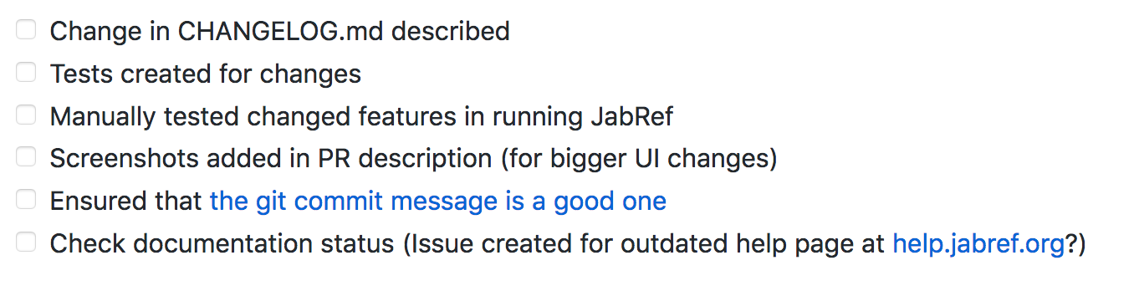
Submitting your changes
Check the submission process
Pull-request?
Code review system (Gerrit)
Tools and needs
License Agreement
Release notes changing
Re-read the contribution guidelines

Slide 25

Follow up your submission
Own it!
Be responsive
Revise it
Discuss it

Slide 26
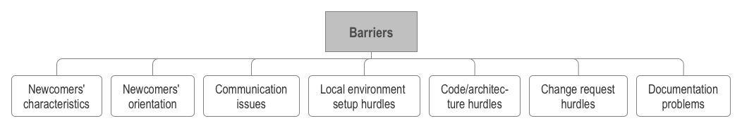
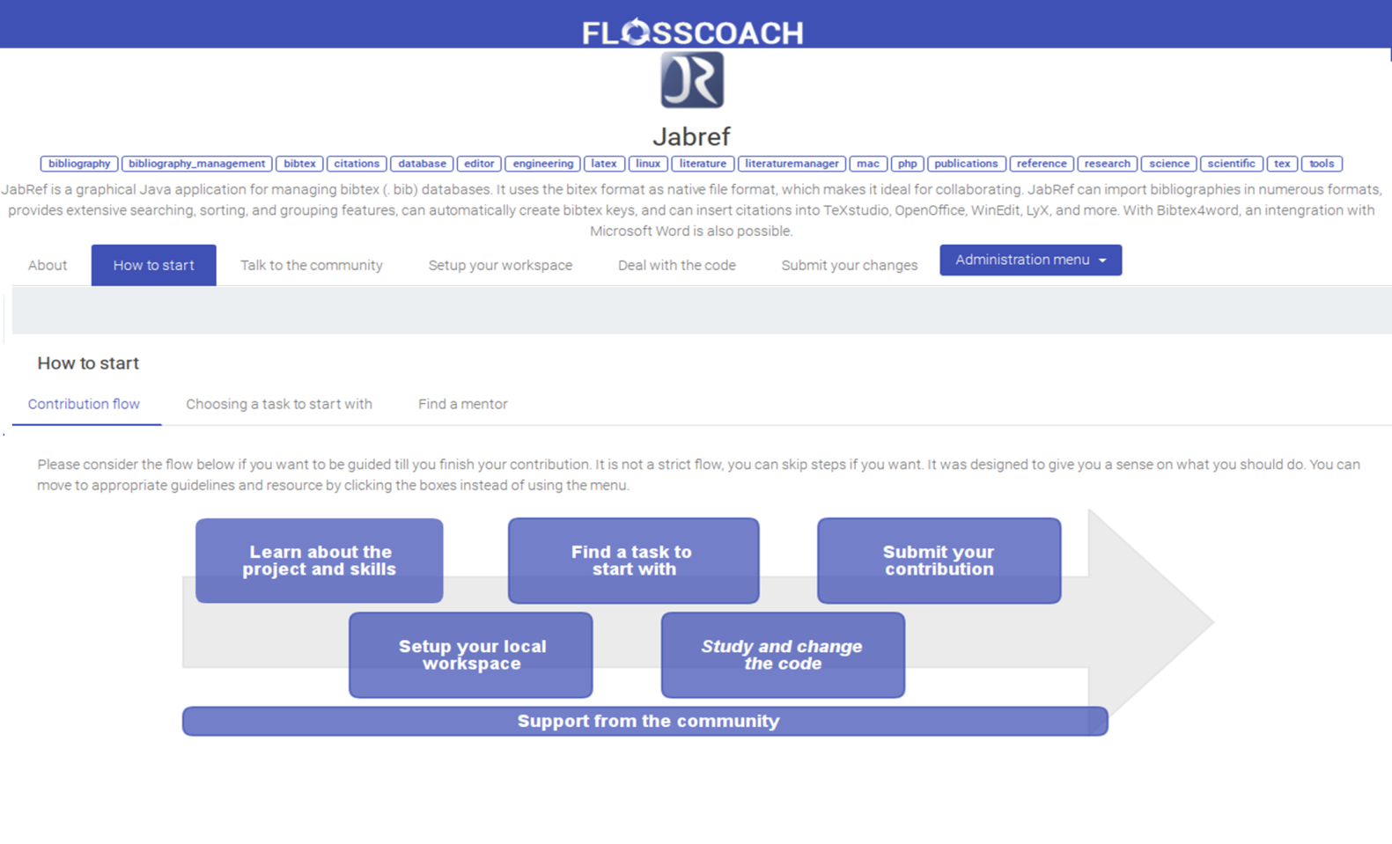
How are we approaching the problem?

Slide 27
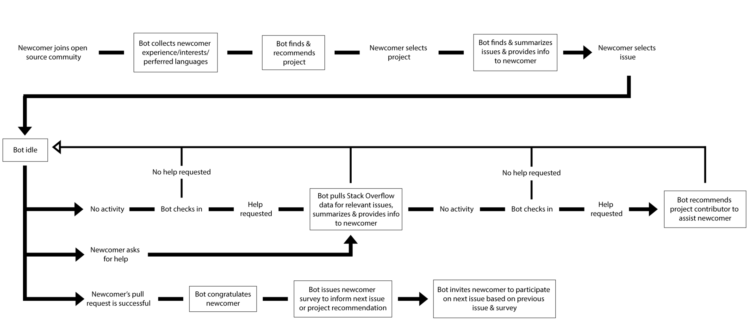
How are we approaching the problem?

Slide 28
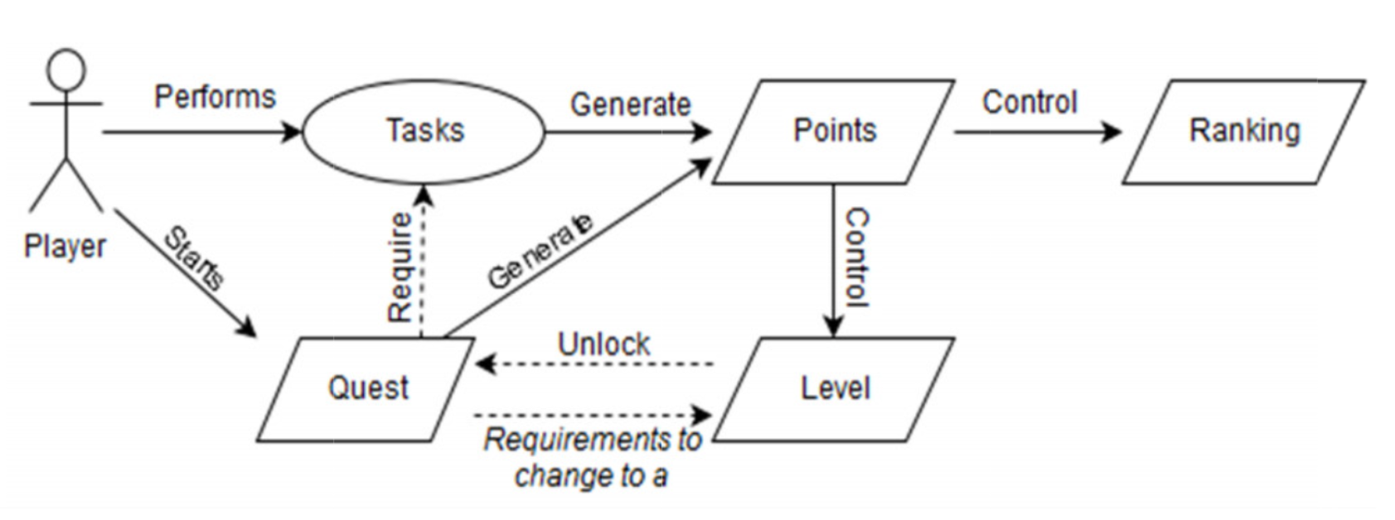
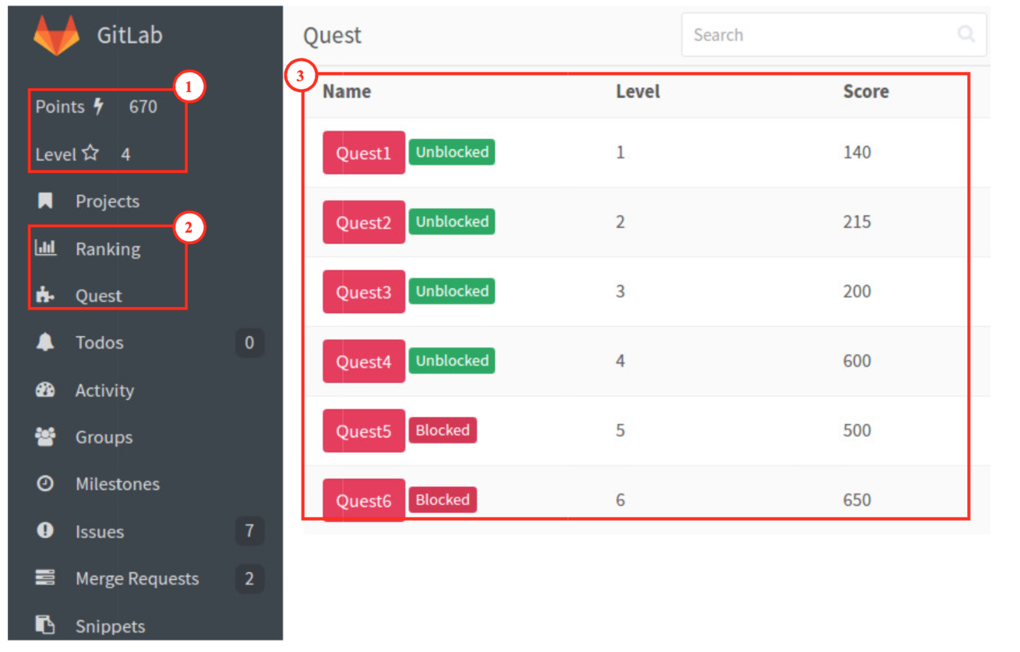
How are we approaching the problem?

